Slide 1
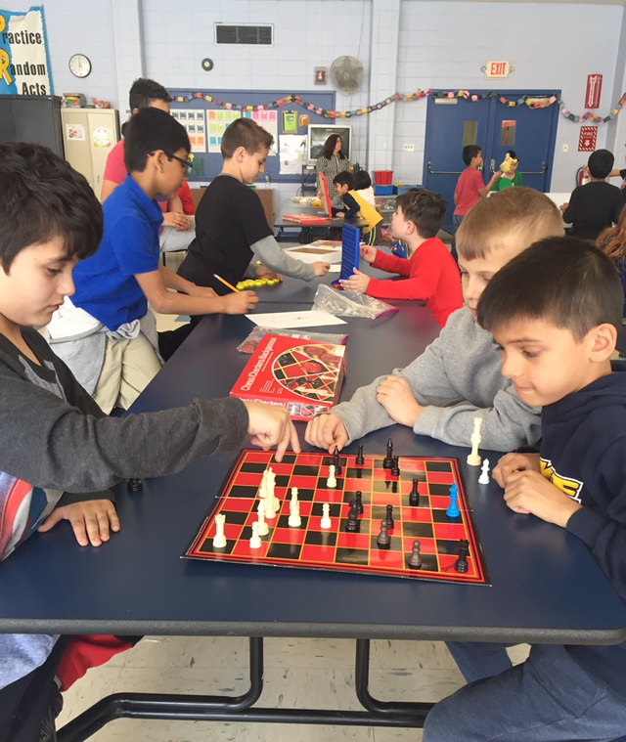
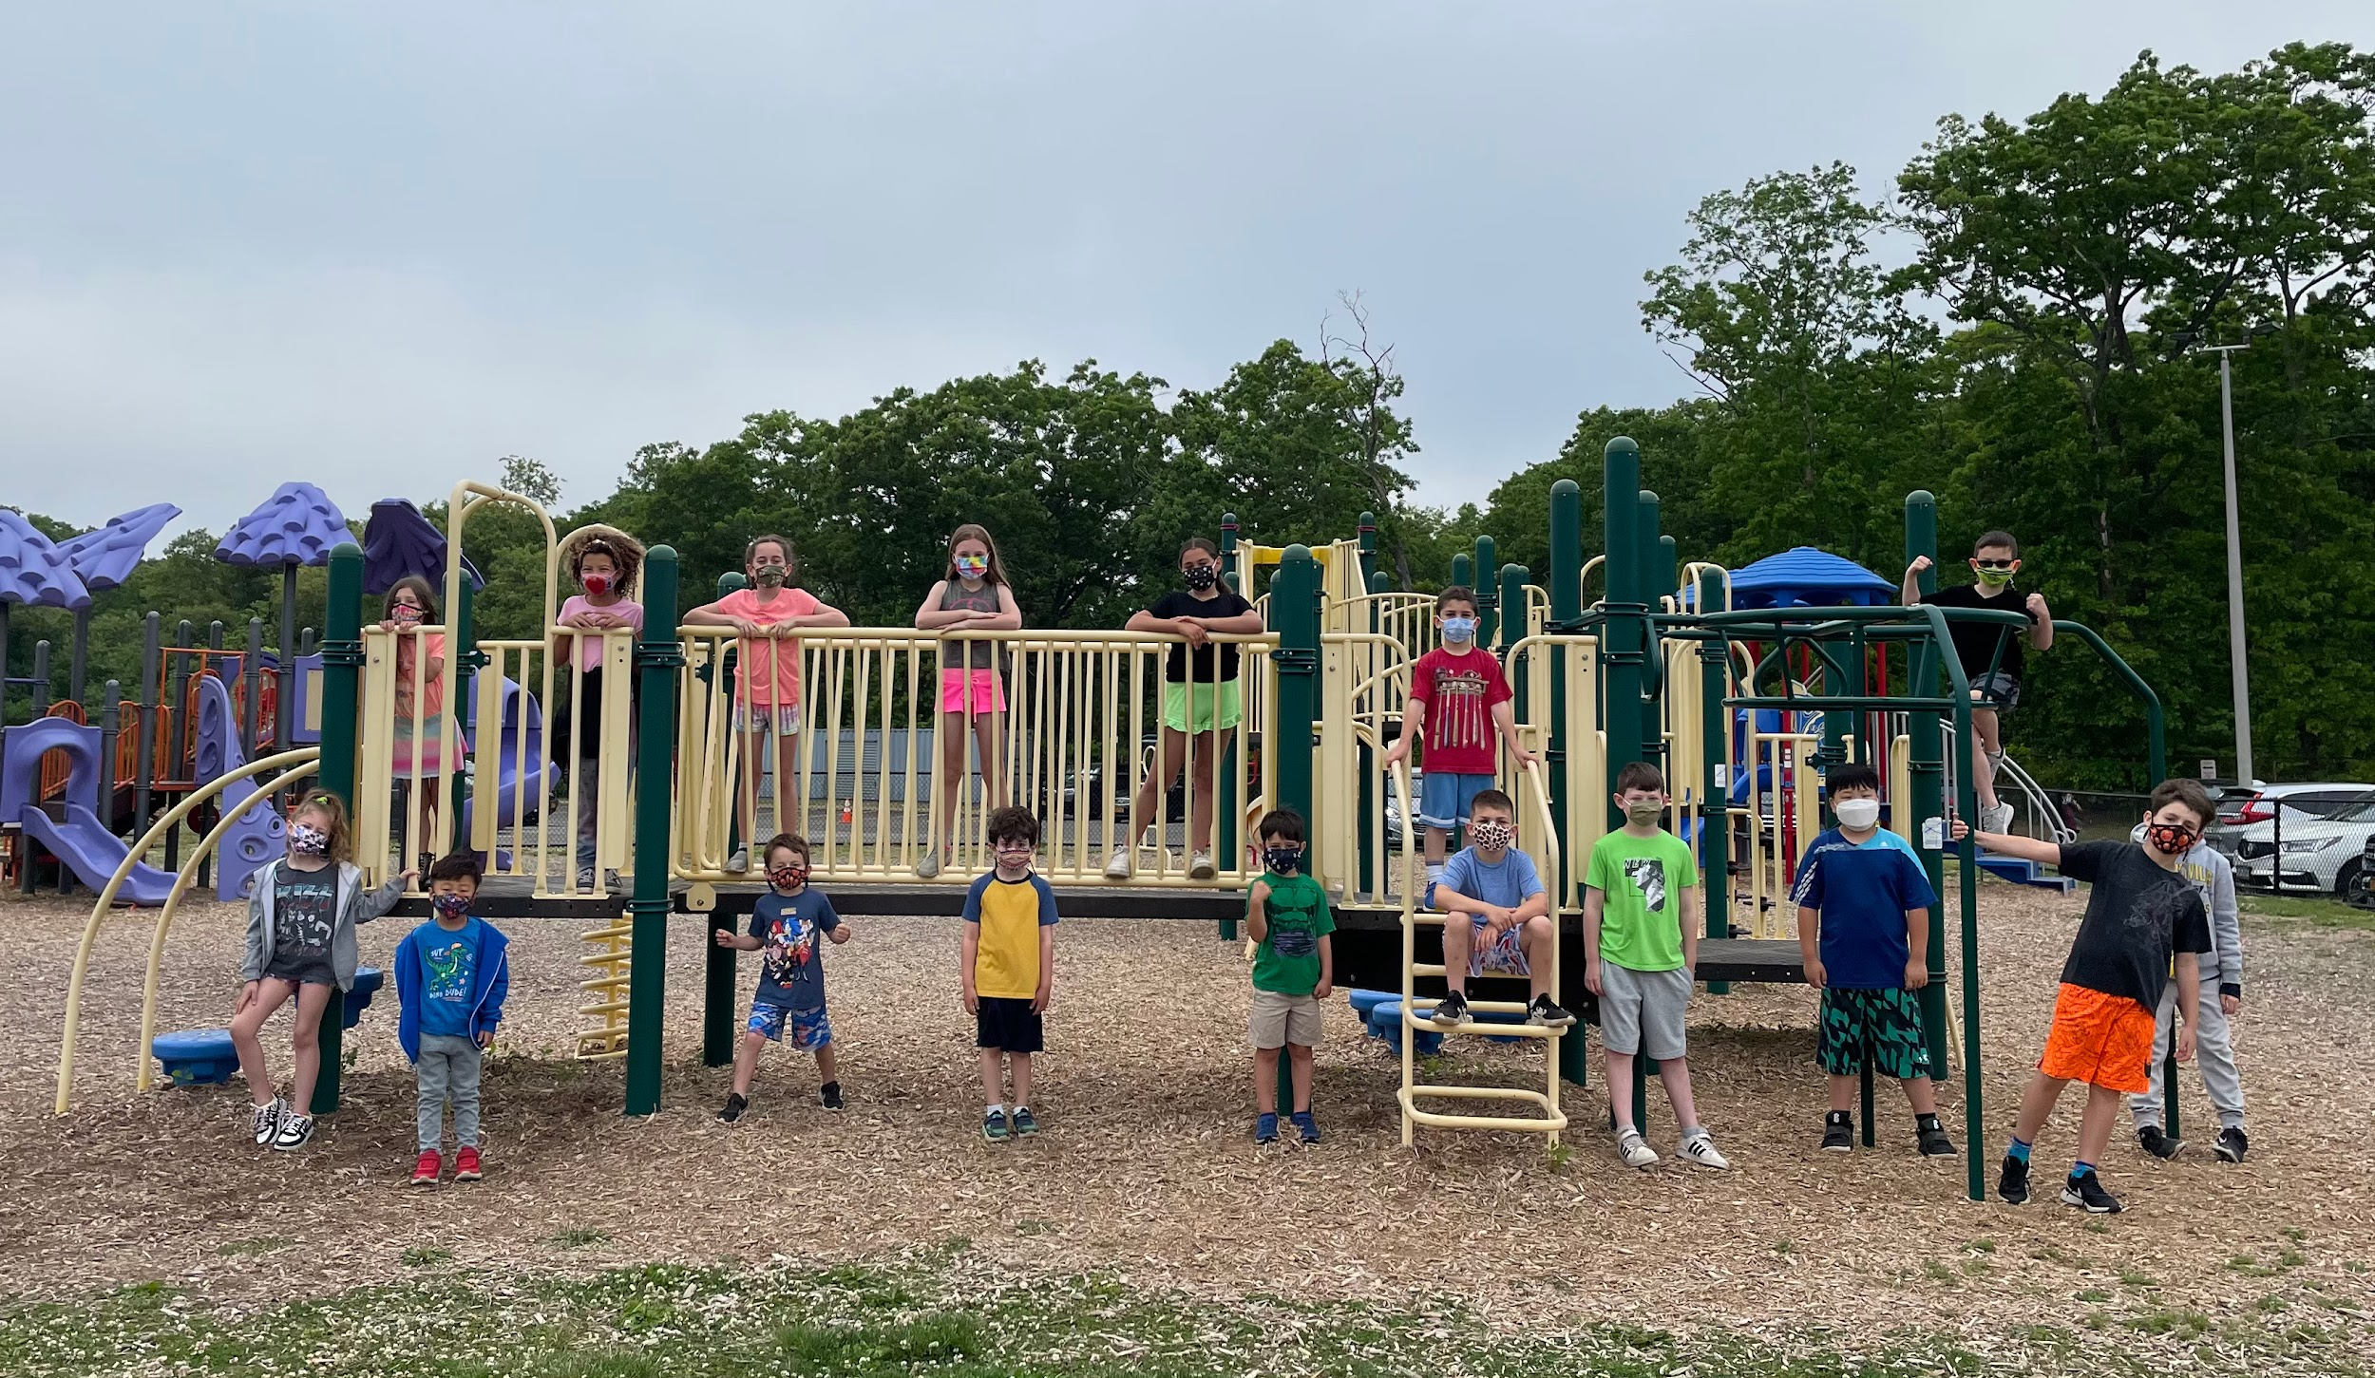
Welcome to the
Plainview- Old Bethpage
Child Care Program

Slide 2
Staff
Cheryl Dender – Child Care Coordinator
Jeremy Ritter - Child Care/4th R
Alex Tory - Daytime Clerical
Ratio: 10:1
Child Care staff consists of certified
teachers, district employees, college graduates, current college students and high school students.
Security guard is on duty in the mornings and the afternoon.
All staff are CPR, First Aid and Epipen certified.

Slide 3
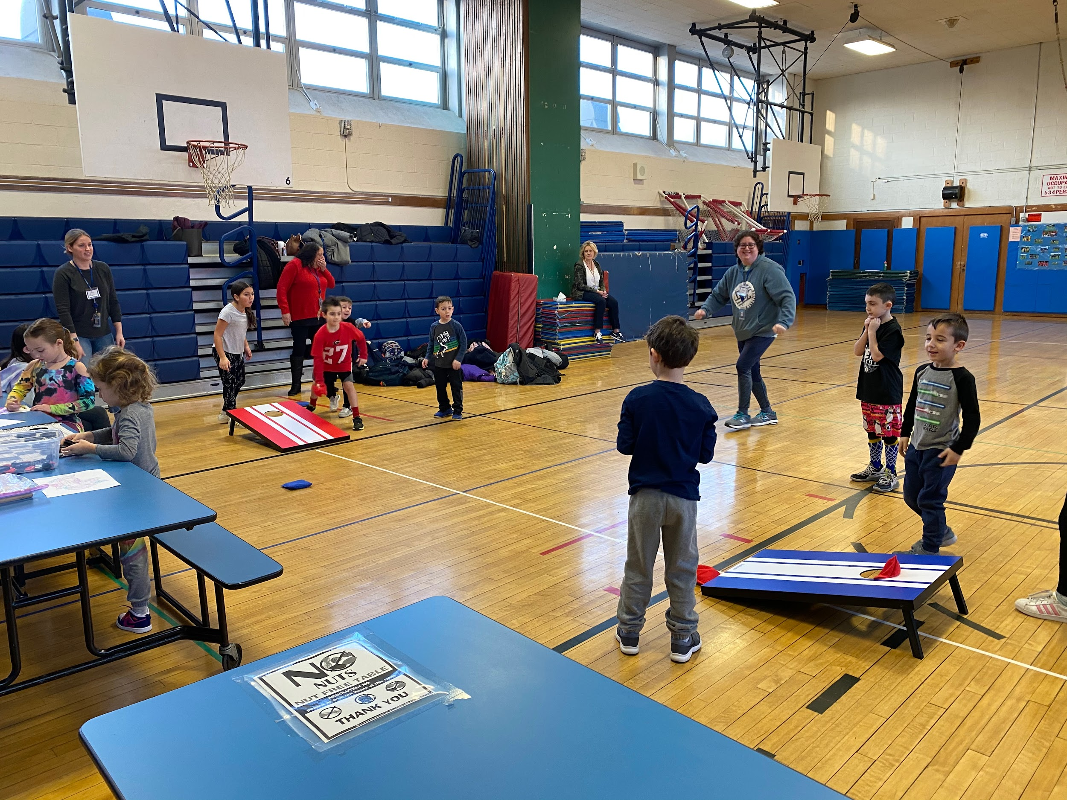
Child Care Availability
Morning Child Care is Available at:
All Elementary Schools and both Middle Schools (pending enrollment).
Afternoon Child Care is Available at:
All Elementary Schools and both Middle Schools (pending enrollment).
Hours of Child Care
Morning: Drop Off Time:
Starting at 7:00 AM for all schools
Afternoon/Evening: Pick-up Time:
Elementary: 5:15 p.m. or 6:15 p.m.
Middle School: 5:00 pm or 6:00 p.m.

Slide 4
Billing
Registration fee is non-refundable and will be $50 per child.
Rates will be as follows:
Morning session - $16 per day
Afternoon session until 5:15 PM - $16 per day
Afternoon session until 6:15 PM - $24 per day
There is no sibling discount.
For those wishing to pay in full at the start of the school year, you will be given a 10% discount off of your yearly bill. This discount is only in effect if your bill is paid in full by September 1st for the first day of school start. Those registering later, can still qualify for the 10% discount if their invoice is paid in full before starting the program. If you have paid in full, and withdraw, you will lose the 10% discount, and will be credited back the unused time based on our full rates.
There is also a mandatory minimum registration of six school weeks.
Your monthly payment will be determined by calculating, on an individual basis, the amount of sessions for which your child is registered during the course of the year. The total number of sessions, multiplied by the session rate will be your total amount due for the school year. We will then divide that amount into equal monthly payments.

Slide 5
Billing (continued)
Extra Hours will be billed separately at the rate of $10.00 per hour and payment must be received within 15 days of billing. Late pick-ups beyond the scheduled closing time of the child care center your child attends, will be subject to an extra $25.00 per hour surcharge.
There are no credits given for snow days, after school extra-help, or music.
Payments can only be made by credit card, check or money order. Please write your child’s name in the memo.
All credit card payments are made through MySchoolBucks.com.
Please use a separate check for each child.
All monthly payments must be received by the first of every month.
The schedule that you choose, when you register your child, will need to remain in effect until October 21, 2024. Two changes to your child’s schedule will be allowed for the school year. The first opportunity to change will be between October 21st and January 31st and the second change will be allowed between February 1st and May 30th.

Slide 6
MySchoolBucks

Slide 7
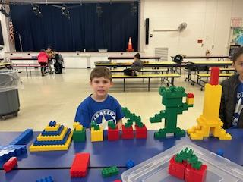
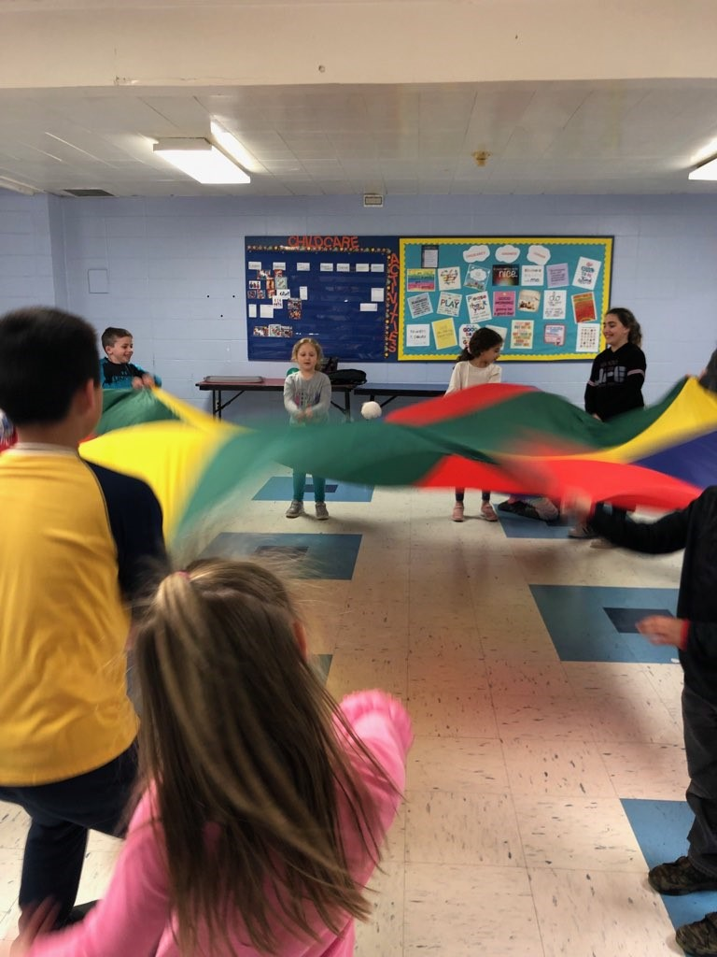
Typical Day AM
Drop your child off with security at the front entrance of your school.
Breakfast will be provided.
Activities including games, crafts, use of the gym, and the playground.

Slide 8
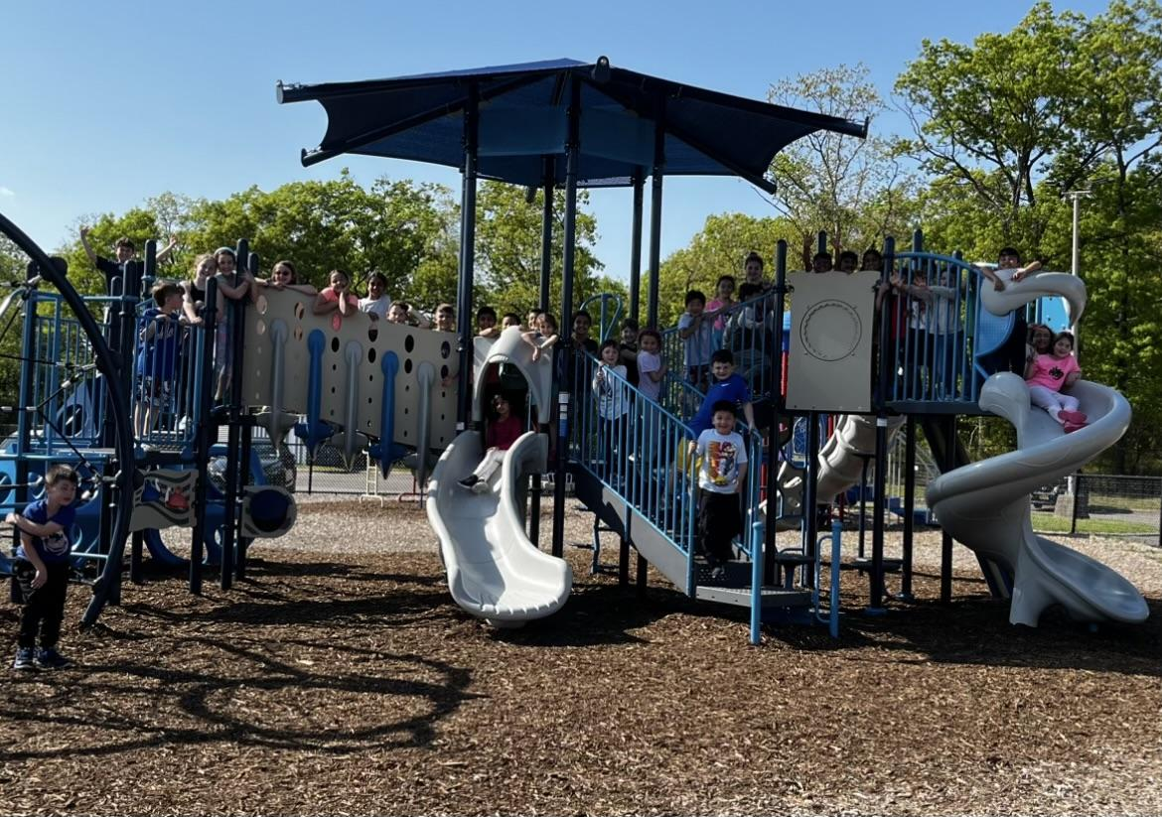
Typical Day PM
Attendance is taken.
First 30 minutes - homework and snacks
Snacks include a variety of nut-free cookies, pretzels, fruit snacks, cheese-its and juice.
Activities include games, crafts, playground and organized activities.
Parents or authorized adults ONLY must sign out their child with security and must show photo ID. Security will radio for your child to be brought to you.
Parents will have no access to the child care area.

Slide 9
Middle School Procedures
Middle school students must check in with child care before going to extra-help or music.
Parents must call or email the child care director if your child is in school, but will not be attending child care.
Possible combining of both middle school childcare programs, if enrollment is not sufficient.

Slide 10
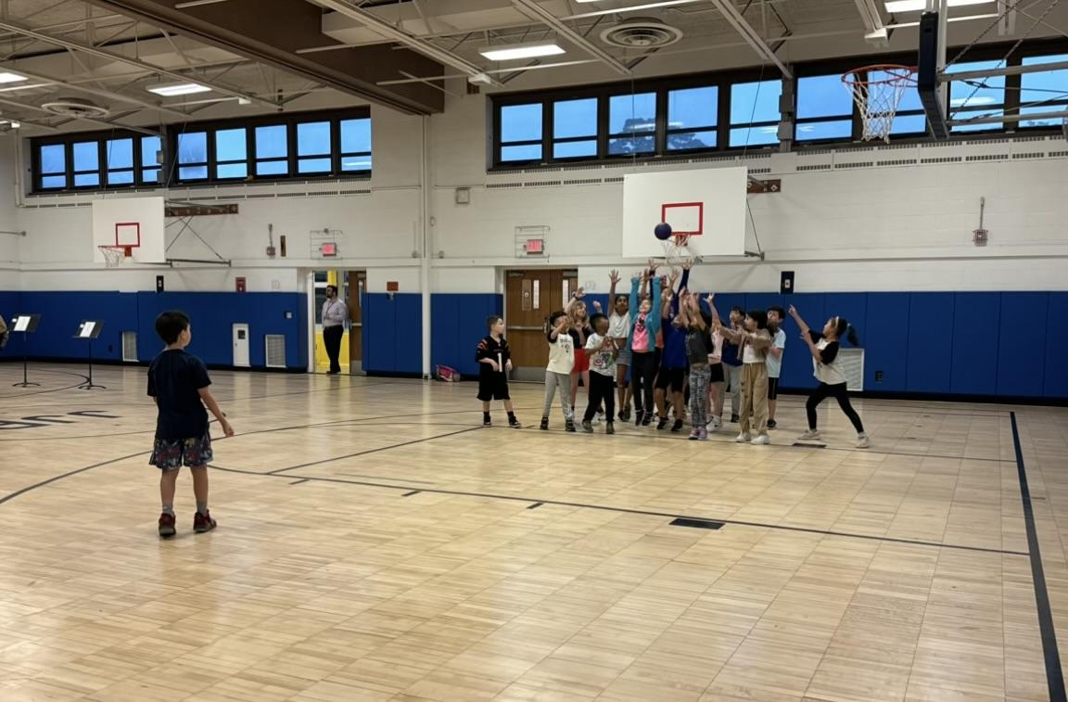
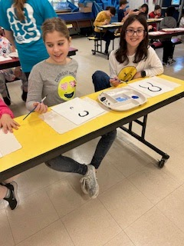
HALF DAYS
A separate half-day registration notice will be e-mailed to you each scheduled half-day. The registration will be done through Family ID.
No child will be permitted to attend the half-day program if the child care office does not have their registration.
There is no half-day program at the middle schools.

Slide 11
Paperwork
Registration will begin on June 4, 2024, and will continue on a first come-, first-served basis. Please do not register until you are absolutely sure of your schedule. Registration will be done through Family ID, our online system.
There will be a cap on the amount of children attending each day, but we do not anticipate any issues going over that cap. If any building is getting close to the maximum cap, you will be
notified by email.

Slide 12
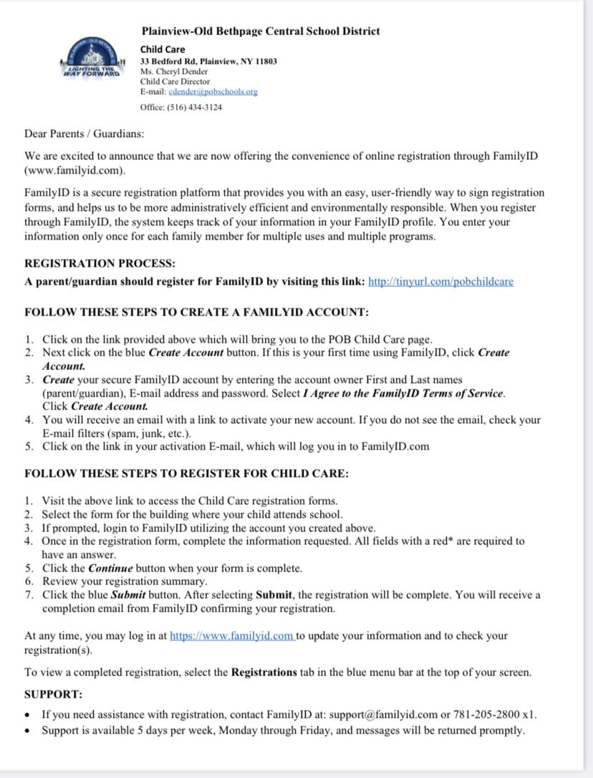
Family Id Welcome Letter

Slide 13
E-STEAM

Slide 14
E-STEAM

Slide 15
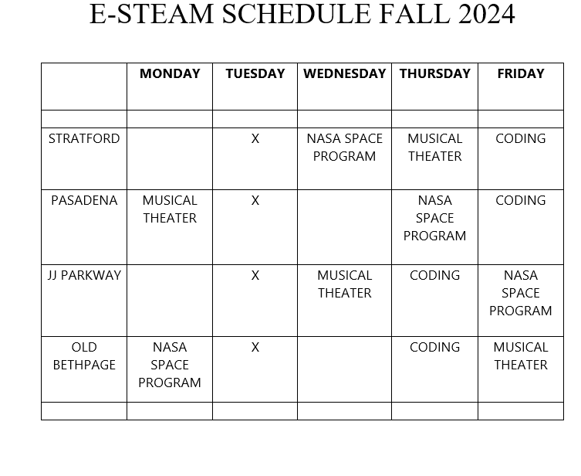
ESTEAM

Slide 16
Office Hours
The child care office is located in the Administrative Annex at Stratford Road Elementary School on 33 Bedford Road.
The office hours during the school year are from
8:30 AM – 6:15 PM. Office hours during the summer are subject to change; please call to find out the hours.
The Child Care phone number is 434-3124, and my email address is CDender@POBschools.org. I am always available to address your concerns. Please do not ask child care staff for their cell phone numbers.

Slide 17
Any questions?

